Slide 1
The Lifelong Loan Entitlement (LLE) March 2023

Slide 2
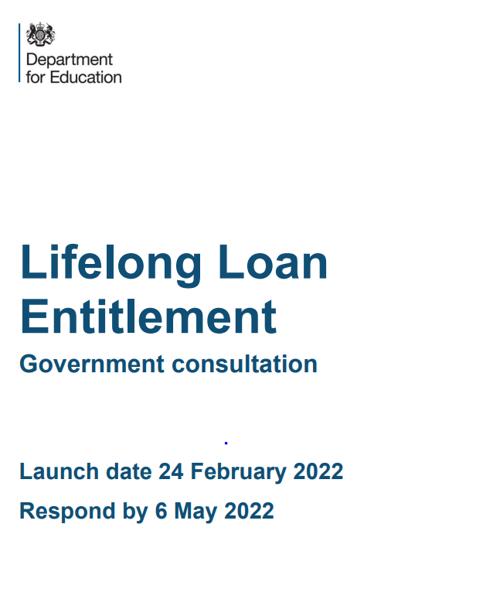
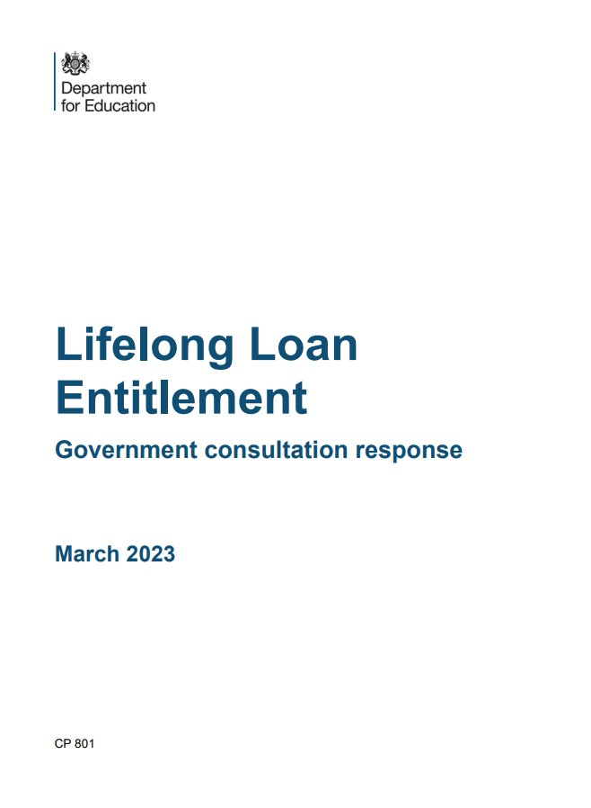
Lifelong Loan Entitlement (LLE) consultation and response
The LLE was announced by the then Prime Minister in September 2020. Since then…
1
2
The Department for Education ran a consultation on the LLE in February until May 2022. The consultation was aimed at anyone with an interest in post-18 education for adults in England.
The consultation included 49 questions and was divided into three themes; 1) LLE Ambition, 2) Scope of the LLE and 3) Supporting Quality provision and flexible learning
On 7 March 2023, the Government published a government response to the LLE consultation.
This consultation response reconfirms the Government’s commitment to the LLE which will transform the way people access high quality learning and enable people to train, retrain and upskill over the course of their lifetime.
The following slides summarise the key elements of the response.

Slide 3
1. Overarching messages
Through the LLE, the Government is seeking to create a unified student finance system for Further and Higher Education.
From 2025, learners can access four years of tuition funding (£37k in today’s fees) to train, retrain and upskill throughout their lives.
Higher education courses at levels 4 to 6, whether academic or technical, will be funded through the LLE. This will include:
Courses currently funded by HE student finance (e.g. undergraduate degrees, Higher Technical Qualifications);
Courses currently funded by Advanced Learner Loans (ALLs) with clear learner demand and employer endorsement; and
Post Graduate Certificates of Education (PGCEs), Integrated Masters, and Foundation Years part of a degree course.

Slide 4
2. Increased flexibility
Through the LLE there will be increased flexibility for learners in how they choose to study, broadening access to funding for eligible modules, not just full courses.
Making sure everyone can continue to access high quality education and training in a way that works for them at any stage of their life or their career is of upmost importance for this Government.
To ensure we get this right we will be taking a phased approach to introducing funding for modules starting from academic year 2025/26 with:
Higher Technical Qualifications
ALLs at levels 4 and 5
Phased
approach
Ensuring
module
quality
Modules must be from a single ‘parent course’ that can be stacked towards full qualifications.
Modules must be credit bearing, with a 30-credit minimum, which can be achieved by ‘bundling’
Modules must have a single assigned academic level i.e. Level 4
Learners will receive a standardised transcript on completion
Removing
restrictions
The Government will be removing unnecessary barriers to learning such as ELQ restrictions.
This means returning learners can train, retrain, and upskill based on their remaining loan entitlement, rather than prior qualifications achieved.

Slide 5
3. Entitlement, maintenance and repayments
Entitlement
Individuals will have access to a loan entitlement worth the equivalent of four years of post-18 education funding (£37,000 in today’s fees) to allow them to train, retrain, and upskill.
The Government will be offering this four-year entitlement to both new, and returning learners (who will have access to a residual entitlement).
LLE tuition fee loans will be available up to the age of 60.
An additional entitlement, above the core four-year entitlement, will be made available for a limited number of priority subjects and longer courses.
Maintenance
For the first time, under the LLE, we are expanding maintenance support to be offered across all eligible L4-6 technical and part-time courses on a par with traditional full-time study.
A reduced-rate maintenance loan will continue to be available for those over 60
Repayments
Loans taken out for LLE courses and modules will be repaid under Plan 5 terms and conditions, with a 9% repayment rate paid on incomes above £25,000.
Excluding postgraduate loans, learners will not be required to repay more than 9% of their income above the relevant thresholds – even if they have loans under Plan 5 and Plan 2 (post-2012 loans).

Slide 6
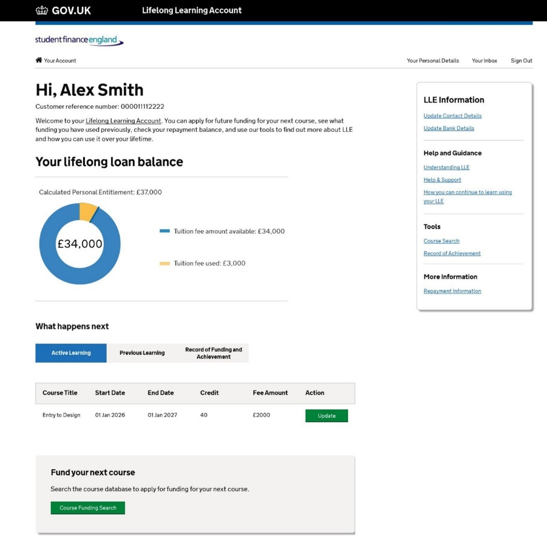
4. Personal account
Learners will be able to access their LLE through an online ‘personal account’ where they can easily view:
Their loan entitlement
Clear information and guidance
Eligible courses
This will help support learners make informed choices about their learning pathway.
How the account looks and its wider functionality, such as the ability to record a learner’s record of achievement, will be subject to user research and testing, so that the account is user friendly and simple to use.
Figure 1. Example of a personal account for a learner accessing their LLE

Slide 7
5. Quality and regulation
Approach: Regulation of the LLE will be delivered through the OfS who will seek to develop a permanent 3rd registration category for providers currently offering L4-6 Advanced Learner Loan (ALL) provision, but who aren’t currently registered with the OfS.
All providers not currently accessing ALL or HESF funding for the delivery of level 4 to 6 courses, who want to deliver LLE-funded provision from academic year 2025/26 onwards, will be able to apply to the existing two registration categories at any stage.
Appropriate regulation: The Government expects that OfS will continue to regulate providers in a proportionate way, as they currently do and will support the OfS in ensuring the regime is clear.
Next steps: The OfS will be consulting later in the year (2023) on the conditions of this new category.

Slide 8
6. Credit transfer and fee limits
Credit transfer
The Government will not impose credit transfer arrangements, but instead seek to facilitate credit transfer through other methods.
This will include through:
introducing the requirement for providers to provide a standardised transcript on completion of modules
personal account functionalities where possible e.g. information, advice and guidance.
Fee limits
Although already announced ahead of the consultation response, on the 1 Feb 23 the Lifelong Learning (Higher Education Fee Limits) Bill was introduced into parliament.
This bill will create a system for applying fee limits to courses and modules offered by providers in the OfS Approved (Fee Cap) category, to ensure that fees are proportionate, fair, and consistent across both full courses and modular, more flexible study.

Slide 9
Next steps
The next steps in the pathway to the LLE are:
Publish in Autumn 2023 - courses eligible for additional entitlement and the principles for the calculation of residual entitlement
Work with providers of Advance Learner Loans (ALLs) to embed changes
OfS will consult on the development and introduction of a new third registration category
Publish an update on Alternative Student Finance (ASF) by late 2023.
Launch a technical consultation on wider expansion of modular funding next year
Successful delivery and implementation of the LLE will require a significant culture shift from providers, learners and employers.
Stakeholder engagement and communication will play a pivotal role in achieving this and we are keen to continue engaging in a dialogue with stakeholders.
In particular, we are keen to accelerate sector readiness, and work with providers to identify trailblazers and case studies we can use to champion LLE as we seek to highlight best practice.
Any questions?

