Slide 1
Learning Provider Regional Forums
FE Account Managers
Partner Services
May 2023

Slide 2
Contents
1 | Introduction
2 | Sector updates
3 | Maximising your funding
4 | Troubleshooting
5 | Account Manager / SLC support
6 | AOB

Slide 3
Advanced Learner Loans
Sector updates

Slide 4
Partners Support Desk
Contact drivers / trends:
Reverse Withdrawal to:
amend fee amount
reprocess with a different date
withdrawn in error app as should be suspended
(2) Reinstating auto cancelled applications
(3) Missing evidence queries
(4) Update fees to zero as student has Level 3 entitlement

Slide 5
Notes:
Approved courses 2023 to date
Level 3 88%
Access to HE – 29%
Diploma – 55%

Slide 6
Top 10 learning aims
Level | Learning aim type | Learning aim description
Level 3 | QAA Access to HE | Access to HE Diploma (Science)
Level 3 | QCF Diploma | Diploma in Supporting Teaching and Learning
Level 3 | QCF Diploma | Diploma in Nail Technology
Level 3 | QAA Access to HE | Access to HE Diploma (Health)
Level 3 | QCF Diploma | Diploma in Women's Hairdressing
Level 3 | QAA Access to HE | Access to HE Diploma (Nursing and Midwifery)
Level 3 | QAA Access to HE | Access to HE Diploma (Health Professions)
Level 4 | QCF Diploma | Diploma in Therapeutic Counselling (RQF)
Level 3 | QCF Diploma | Diploma in Nail Technology (RQF)
Level 3 | QAA Access to HE | Access to HE Diploma (Health Professionals)

Slide 7
Sector / policy updates
Plan 5
23/24 new learners
40 year write off
£25,000 threshold
RPI only
23/24 LAUNCH
30 May launch
LAFIL
Contract value
Loan Facility Details
POLICY
ESFA Funding & Performance Rules
PMP Timelines
CPR / Access to HE
Suspension period
LLE
Phased approach
25/26 level 4-5 / HTQs
27/28 all 4-6
ALL remain for L3

Slide 8
LLE – Introduction
Lifelong Loan Entitlement (LLE) is a student finance system being introduced from 2025/26 to provide funding for people to study over their working lives
DfE will set and own the LLE policy
SLC will administer the LLE system
OfS will be accountable for the Register of Providers
Unlikely to be any significant changes to nationality, citizenship or residency rules
Prior government funding of tuition fees support at L4-6 will be taken into account when determining levels of available LLE
Funding at modular level will be phased in over time

Slide 9
Module eligibility in 2025/26
The government will take a phased approach to providing funding for modules
On launch in AY 2025/26, new modular funding will only be provided for certain courses including All Higher Technical Qualifications (HTQs) and some technical qualifications at levels 4 and 5 currently funded through ALLs
LLE funding for modules of undergraduate degrees will be introduced from AY 2027/28
Each module must carry a minimum credit value of 30 credits
Providers will have autonomy on whether or not to modularise a course

Slide 10
LLE - Key Messages
Repayments
Loans taken out for LLE courses and modules will be repaid under Plan 5 terms and conditions, with a 9% repayment rate paid on incomes above £25,000
Learners will not be required to repay more than 9% of their income above the relevant thresholds – even if they have loans under Plan 5 and Plan 2 (post-2012 loans)
Entitlement
Individuals will have access to a loan entitlement worth the equivalent of four years of post-18 education funding (£37,000 in today’s fees) to allow them to train, retrain, and upskill
Available to both new and returning learners
LLE tuition fee loans will be available up to the age of 60
An additional entitlement will be made available for a limited number of priority subjects and longer courses
Maintenance
Maintenance support to be offered across all eligible L4-6 technical and part-time courses on a par with traditional full-time study
Reduced-rate maintenance loan will continue to be available for those over 60

Slide 11
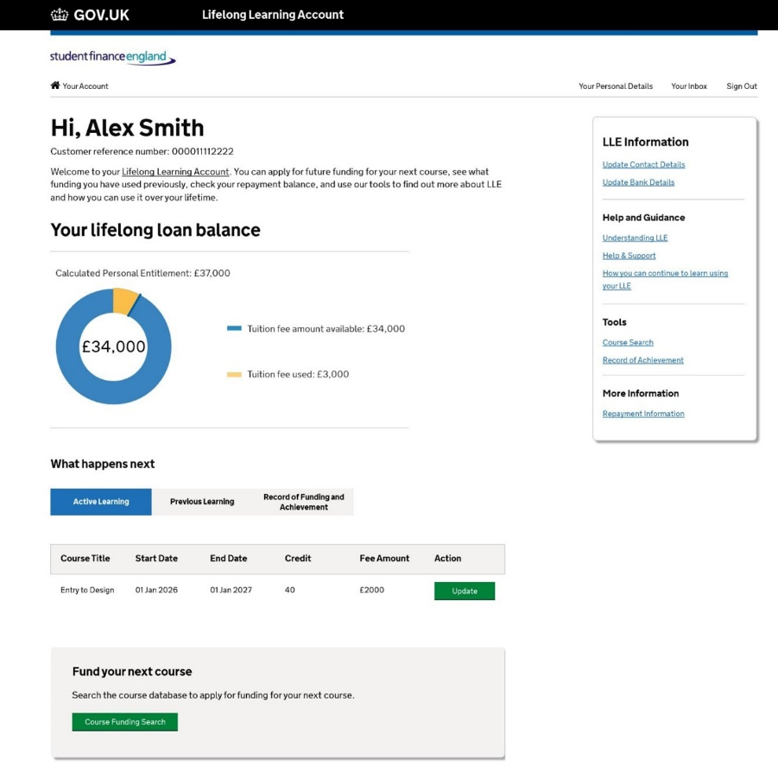
LLE – Personal account
Learners will be able to access their LLE through an online ‘personal account’ where they can easily view:
their loan entitlement
clear information and guidance
eligible courses
This will help support learners make informed choices about their learning pathway.
How the account looks and its wider functionality, such as the ability to record a learner’s record of achievement, will be subject to user research and testing, so that the account is user friendly and simple to use.

Slide 12
LLE – under consideration
CPR
Residual Entitlement
Alternative Student Finance

Slide 13
LLE – next steps
The next steps in the pathway to the LLE are:
December 2023 – review of ALL funded qualifications, outcome January 2024
OfS consulting on the development and introduction of a new third registration category
Work with providers of Advance Learner Loans to embed changes
Launch a technical consultation on wider expansion of modular funding next year
Courses Management - launch forecasted for Oct 2024
Apply to Pay - launch forecasted for April –Sept 2025
Further information can be found in the Government consultation response

Slide 14
Advanced Learner Loans
Maximising your funding

Slide 15
Monitoring your facility
SLC
Provider
ESFA
LAFIL control
Curriculum planning
Compliance – ESFA and SLC
LP Portal financial reports
Performance management points

Slide 16
Performance management points
In 2023/24, there will be two review points:
September 2023: first review point for increases, reductions and new facility requests
January 2024: second review point for increases, reductions and new facility requests
ESFA will offer additional funding (within the growth limits) to good performers (criteria set out in the funding and performance management rules)
Growth limited to £250k for entire funding year, regardless of loan facility value if:
published overall Ofsted grade is ‘requires improvement’
you have not yet had an Ofsted inspection
you have not yet had your qualification achievement rates assessed against ESFA’s minimum quality standards
* To be confirmed in draft 2 of ESFA Funding Rules
Facility as at 1 Aug 2023 | Maximum facility growth for 2023/24
Up to £100k | £50k
Over £100k | £1.5m or 50% of facility (whichever is lower) – limited to £750k at a single review point

Slide 17
Advanced Learner Loans
Troubleshooting

Slide 18
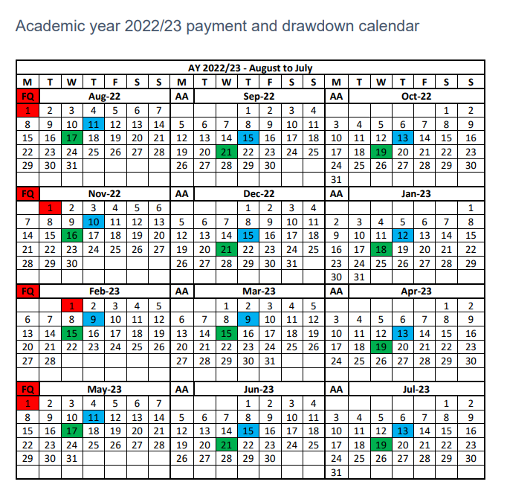
Pre liability and attendance
Work towards the monthly draw down date to ensure compliance
ULN and initial attendances due within six weeks of course start date (measured at next available draw down date)
Only reinstate a cancelled app when you are ready to confirm attendance (attendance due 2 weeks)
When reinstating auto cancelled app - you must add the ULN/confirm initial attendance same day to avoid the app reverting to auto cancelled again

Slide 19
Attendance management policy
Expectations clearly set out for learners and
teaching staff?
Does it include information on:
Cooling off period (in line with ALL 2 weeks liability point)?
Non-attendance – trigger point
Suspensions / withdrawals 60 days < achievable?
Is there anything SLC could do to help you meet the service standards?

Slide 20
Pre- Liability COCs
What prevents you submitting 60% of suspensions and withdrawals in 60 days?
What changes can you make internally to enable you to achieve this service standard?
Is there anything SLC could do to help you achieve this?
Pre- Liability COCs

Slide 21
Advanced Learner Loans
SLC support

Slide 22
Account Manager engagement in 2022/23
262 Provider engagements:
72 face to face meetings
190 Teams meetings

Slide 23
Provider feedback
It was very useful to meet again on a
face to face basis
I think a meeting every few months would be good to make sure everything is being done correctly on our part
I found it reassuring that other providers seem to be experiencing the same difficulties
Do not need to have much to do with FE account manager
I very rarely get emails direct as I am lower down the list

Slide 24
Account Manager / SLC support
Provider visits
Staff development days?
Provider comms / resources
Bulletins
LP Services website
Status reports
Summary of service standards compliance

Slide 25
Advanced Learner Loans
AOB

Slide 26
Cyber security
Protect
Prevent
Support
Protect SLC’s IT infrastructure
Prevent data loss
Provide support to LPs / learners

Slide 27
Follow up actions…
Check Contracts Manager has digitally signed and returned 23/24 loan facility contract
Opportunity to challenge contract value – 6 week window
Ensure 2023/24 loan facility is visible on LP Portal ahead of application service launch
Ensure LAFILs are not issued ahead of 30 May to avoid applications being made ineligible
Consider how SLC can support your wider organisation to drive up service standard compliance
Please provide any feedback or questions about Lifelong Loan Entitlement to your Account Manager

Slide 28
Contact information
FE Account Management Team
Partner Services
LPServices@slc.co.uk
0300 100 0643
https://www.lpservices.slc.co.uk

