Slide 1
Lifelong Loan Entitlement (LLE) – Next steps planning
Introduced by:
Paul Smith
Head of Partner Services
SLC

Slide 2
LLE introduction
Lifelong Loan Entitlement (LLE) is a student finance system providing up to 4 years of funding for people to study over their working lives
The funding is worth £37,000 (at the current value of tuition fees)
LLE can be utilised to fund study across post-18 qualifications from levels 4-6, either through studying for a full qualification, or through modules of these qualifications
Funding at modular-level will be phased in over time
To be eligible for LLE, a course must be defined in terms of the credit value of the full degree programme or of a module component – “this course/this module carries X credits”

Slide 3
Organisational roles
DfE set and own the LLE policy, and the statutory provisions made through regulations
SLC will be the accountable organisation for the administration of the LLE system, concurrent to its existing roles for student finance for Welsh, NI and Scottish students, and for English students completing courses on the current HE student finance system
OfS will be accountable for the Register of Providers who can assess suitability for funding, and the setting of initial and ongoing Conditions of Registration
IFATE approves and publishes which providers can deliver HTQs
SLC will work in partnership with careers advisors, guidance staff and FE and HE recruitment and outreach teams to incorporate student finance into wider engagement on education participation

Slide 4
Personal eligibility
There is unlikely to be significant change to nationality, citizenship or residence rules
Students will be eligible irrespective of any equivalent level qualifications, which no longer apply
Applicants must be age 60 or lower on the intended start date of their course. So a mature student moving through a modules-based pathway needs to consider their age limit for each course undertaken if they could be aspiring to a full qualification
Reduced rates of maintenance loans for students aged over 60 at the start of their course
Prior government funding of tuition fees support at L4-6 will be taken into account when determining levels of available LLE

Slide 5
General course eligibility changes
Course eligibility - continuing requirements | Course eligibility changes
Must lead to a recognised qualification | Must be scheduled as 3 academic terms over a year
Must be provided by an OfS authorised provider | Must be designed to provide an average 21 hours of self- and guided-learning over a minimum 24 weeks
At least 50% guided learning must be delivered within the UK | Credit values of courses must be definable
Must have academic years not exceeding 12 calendar months.
Tuition fees and fee loans must be paid direct to a UK bank account
Providers must adhere to guidance from the Competition and Markets Authority
Tuition Fees / Fee Loan limits must be charged to a maximum regulated amount

Slide 6
Course eligibility in 2025/26
Level 4-6 courses delivered in the UK that are eligible for funding for English-domiciled student under the current SFE service
All qualifications which currently attract SFE funding as undergraduate courses. This includes:
PGCE ITT courses at level 7
medical courses years 4 and 5
integrated master’s courses
foundation years which are part of a degree course
ALL-funded Level 4-6 technical qualifications. The finalised list of approved qualification will be confirmed following a technical consultation
Eligible courses that are in certain priority areas or longer than the standard 4 year entitlement may be able to access additional entitlement, considering additional entitlement for ‘special years’ – Foundation, placement, study abroad etc.

Slide 7
Module eligibility in 2025/26
Qualifications currently funded under ALL at Levels 4-6
HTQs currently funded under SFE up to academic year 2024/25
Where the full course is eligible and available
Each module must carry a minimum credit value of 30 credits. Each module must carry a minimum credit value of 30 credits, so may require consolidation of modules of smaller credit values in order for the course to be eligible.
NB: Funding under LLE for modules of undergraduate degrees will be introduced from academic year 2027/28

Slide 8
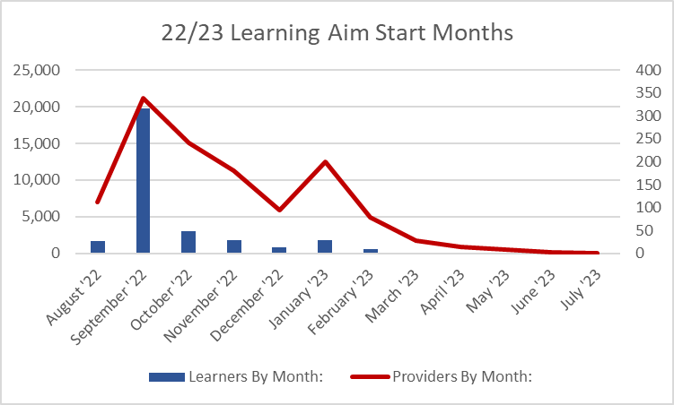
ALL funded learners Level 4/5 (AY 2022/23 to Feb 23)
Learning aim level | 2021/22 approved applications | 2022/23 approved applications
Level 3 | 37,659 | 27,117
Level 4 | 3,271 | 2,953
Level 5 | 798 | 739
Level 6 | 65 | 29
Total | 41,793 | 30,838

Slide 9
Credits and fee loans
The student enrols on the course with defined credits and continues studies (by undertaking guided and self-learning as now), until withdrawal, suspension or transfer
The defined credits for that course have an associated value, derived from the total credits and the cost-per-credit value
As the student starts each module, and upon receipt of a valid attendance confirmation, the loan (to the value of number or credits x cost per credit) is deducted from their LLE Account, added to their ICR loan account and paid direct to the lead provider
As the student starts each full degree programme, upon the receipt of valid attendance confirmation, the loan to the value of the study period is added to the student’s LLE balance

Slide 10
Strategic considerations
Can we afford to offer modular courses / can we afford not to
How do we market modules
Targeted or generic course marketing
Targeted audiences
How easy will it be to price a module – will we always stick to the maximum
What’s our minimum viable student numbers for given module(s)
Direct delivery or through partnerships ?
Will we encourage modular progression for students recruited with low attainment at entry level
With the removal of ELQs, is there a new marketing opportunity
Incorporating IAG into outreach and recruitment
Employer partners and funding IAG
Regulatory framework implications
Inclusion in APPs
Incorporation into TEF measures
IFATE / OfS registers

Slide 11
Operational considerations
How well do students understand credits ?
Incorporating student finance into offers
Targeted or generic course marketing
Targeted audiences
What comes first, the effort of producing a course specification, gaining approval, identifying academic staff and location, or instead, first achieving minimum viable student numbers and then finalising the course.
Accommodation provision for students starting via an initial module(s)
If students studying modules are less likely to require accommodation, what happens if we convert them midway to the full degree.
Course specifications
No minimum duration – only minimum credits
Shorter full time courses
Registration confirmations – centralised or dispersed administration
Hardship support plans for modular-learners

