Slide 1
Learning Provider Regional Forums
FE Account Managers
Partner Services
March 2024

Slide 2
Contents
1 | Introduction and Latest SLC Updates
2 | Future Funding
3 | 24/25 Timelines
4 | Service Standards Review
5 | SLC Support

Slide 3
Advanced Learner Loans
SLC Updates

Slide 4
Partners’ Support Desk
Contact Drivers:
Flagging administrative errors
Reinstating applications
Missing Evidence queries
Update fees to zero as student has Level 3 Entitlement
Calls asking how to become a provider / Progress of ESFA funding requests
Practitioner Support
SSIN_Queries@slc.co.uk / 0300 100 0618
For detailed information regarding policy, regulations, eligibility or circumstantial questions

Slide 7
Top 10 Learning Aims
Level | Learning Aim Type | Learning Aim Description
Level 3 | QAA Access to HE | Access to HE Diploma (Science)
Level 3 | QCF Diploma | Diploma in Nail Technology
Level 4 | QCF Diploma | Diploma in Therapeutic Counselling (RQF)
Level 3 | QCF Diploma | Diploma in Supporting Teaching and Learning
Level 3 | QCF Diploma | Diploma in Adult Care (England)
Level 3 | QAA Access to HE | Access to HE Diploma (Health Professions)
Level 3 | QCF Diploma | Diploma in Sports Massage Therapy
Level 3 | QCF Diploma | Diploma in Gym Instructing and Personal Training
Level 3 | QAA Access to HE | Access to HE Diploma (Nursing and Midwifery)
Level 3 | QCF Diploma | Diploma in Women's Hairdressing

Slide 8
Sector Observations
Reduction in apps but new providers joining ALL scheme
Devolved funding extending to some A2HE provision
Learner commitment free funding v loan funded
Future of devolved funding

Slide 9
SLC Updates
Cyber Security
24/25 Launch
10 June 2024
Plan 5 Repayment
Portal Enhancements
Targeted Bulk Erasure

Slide 10
Future Funding
Lifelong Learning Entitlement (LLE)

Slide 11
LLE – What We Know
Providing up to 4 years of funding worth £37k (at current value of tuition fees)
Learners can use their entitlement flexibly over their working lives to fund full courses as well as modules at levels 4 to 6
Those attending ‘in-person’ that are eligible for LLE tuition funding will also be eligible for maintenance loans and targeted grants
Existing ALL funding extended for a further two years for providers not registered with OfS
Providers able to apply for OfS registration within the existing categories now
Each module must carry a minimum credit value of 30 credits – fee limit based on category of registration
OfS to deliver a full regulatory approach for 3rd category from 27/28

Slide 12
LLE – Things to Consider
IAG
Residual Entitlement
Administration
Ensuring prospective learners aware of which funding mechanism to apply for
Potential drop in 24/25 intake?
Previous student finance will impact future entitlement
Who will be responsible for LLE admin in your organisation?
Will you offer LLE-funded modular courses or remain with your current course structure?

Slide 13
Advanced Learner Loans
24/25 Timelines

Slide 14
24/25 Timeline
Maximum loan amounts remain unchanged
24/25 contract
ESFA Funding Rules to be published in Spring
Performance Management Points
Criteria
Growth/Reductions

Slide 15
Monitoring your Facility
LAFIL Control
Curriculum planning
Performance Management Points
Accuracy
Level 4 + Migration (LLE)
Popular Learning Aims
Exception Case Form
Approved / Suspended included in amount ‘used’
LP Portal Financial Reports
Loan Facility Details
Payment Instalment Report
Timing

Slide 16
Advanced Learner Loans
Service Standards Review

Slide 17
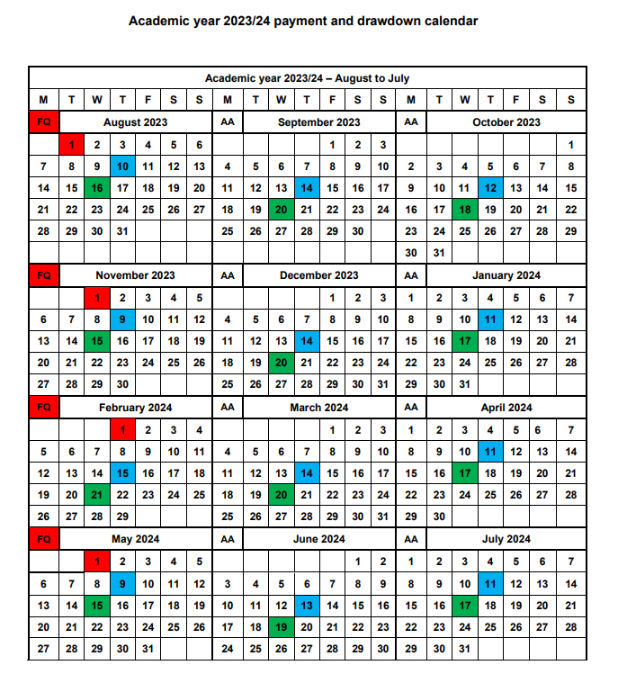
Best Practice
Work towards the monthly draw down dates to ensure compliance
ULN due within six weeks of course start date but can be added immediately
If initial attendance cannot be confirmed within six weeks, option to cancel or push out start date
Only reinstate a cancelled app when you are ready to confirm attendance (attendance due 2 weeks)
When reinstating auto cancelled app - you must add the ULN/confirm initial attendance same day to avoid the app reverting to auto cancelled

Slide 18
Pre- Liability COCs
What can you do to ensure your organisation submits accurate data in a timely manner?
What can you do differently to ensure suspensions and withdrawals are submitted within 60 days?
Is there anything SLC could do to help you achieve this?
Pre- Liability COCs

Slide 19
Advanced Learner Loans
SLC Support

Slide 20
Engagement & Resources
ALL Training Events – May 2024
LLE Roadshows – May to July 2024
1-2-1 Account Reviews
Status Reports
Academic Staff Workshops
Staff Development Days
Monthly Bulletins
LP Services Website

Slide 21
Follow Up Actions…
Check Contracts Manager has digitally signed and returned 24/25 loan facility contract
Opportunity to challenge contract value
Ensure 24/25 loan facility is visible on LP Portal ahead of application service launch
Review Contacts and User list ahead of new academic year
Ensure LAFILs are not issued ahead of 10 June to avoid applications being made ineligible
Consider who within organisation will be responsible for LLE admin (levels 4-6)
Consider how SLC can support your wider organisation to drive up service standard compliance

Slide 22
Contact information
FE Account Management Team
Partner Services
LPServices@slc.co.uk
0300 100 0643
https://www.lpservices.slc.co.uk

